Slide 1

PAIRS TRADING
TEAM:
NUPUR MURPHY
RANDY PAYANO
VICTOR DITURO

Slide 2
STRATEGIZING WITH MACHINE LEARNING
What is Pairs Trading?
Pairs trading is a non-directional, relative value investment strategy that seeks to identify 2 companies or funds with similar characteristics whose equity securities are currently trading at a price relationship that is out of their historical trading range. This investment strategy will entail buying the undervalued security while short-selling the overvalued security, all while maintaining market neutrality. It can also be referred to as market neutral or statistical arbitrage.

Slide 3
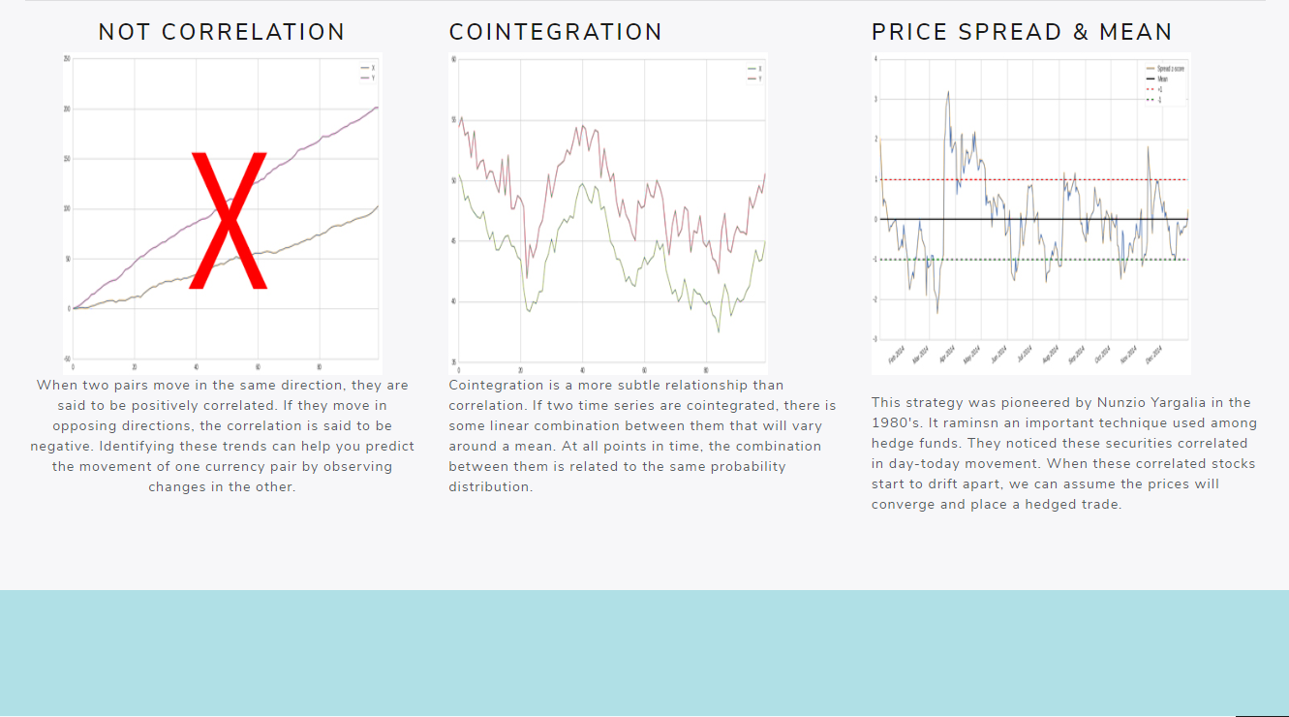

Slide 4
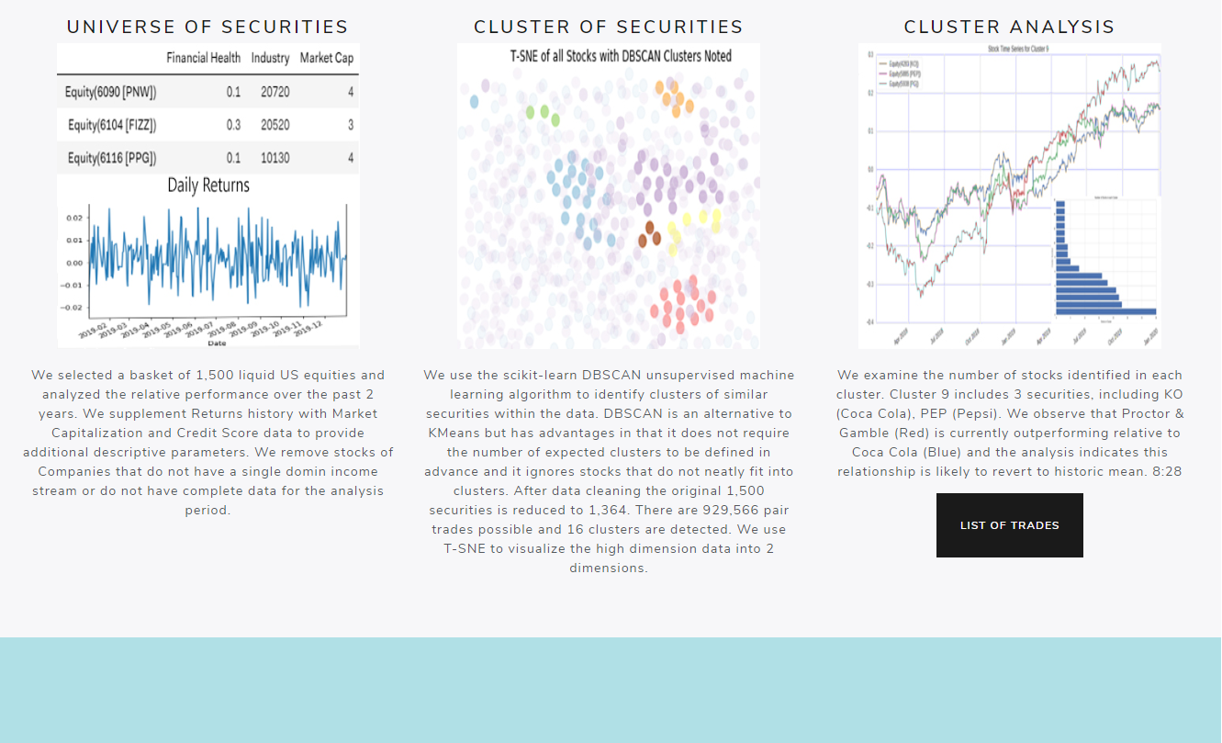
LETS TALK DATA!
First bullet point here
Second bullet point here
Third bullet point here

Slide 5
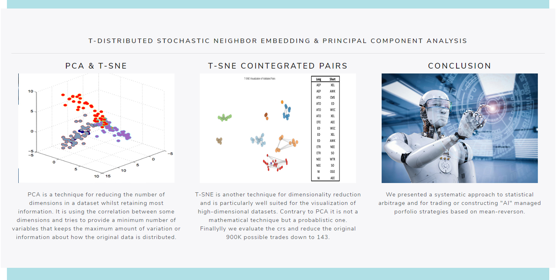
Principal Component Analysis & T-Distributed Stochastic Neighbor Embedding
T-DISTRIBUTED STOCHASTIC NEIGHBOR EMBEDDING & PRINCIPAL COMPONENT ANALYSIS
T-DISTRIBUTED STOCHASTIC NEIGHBOR EMBEDDING & PRINCIPAL COMPONENT ANALYSIS
First bullet point here
Second bullet point here
Third bullet point here
Task 1
Task 2
Task 3

Slide 6
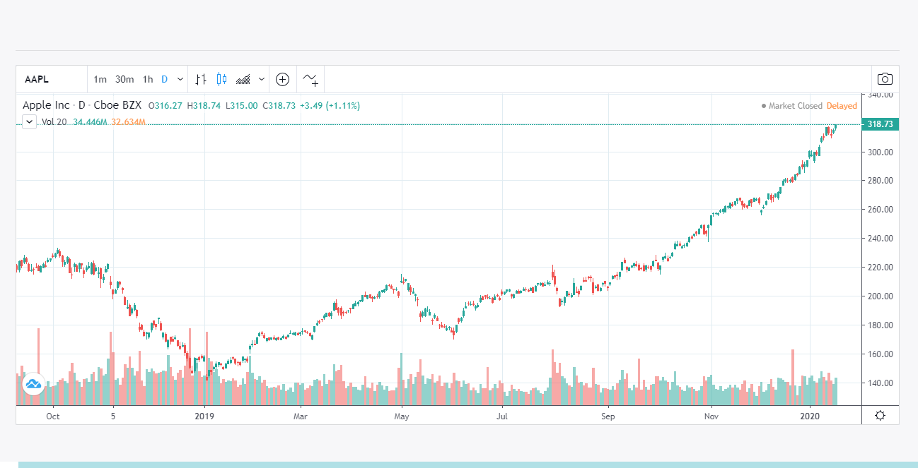
Lets Trade!

Slide 7
Thank you!

